Slide 1
FLYWAY DB

Slide 2
Problem Statements
In the current database we don’t have an automated tool to do the changes
Manually apply the changes to all possible different environments that are available(QA, UAT etc.,)

Slide 3
FLYWAY DB
Make it clear at all times what state a database is in
Migrate in a deterministic way from your current version of the database to a newer one
Apply the changes to multiple environments by single command execution
which all the scripts are executed and which are pending

Slide 4
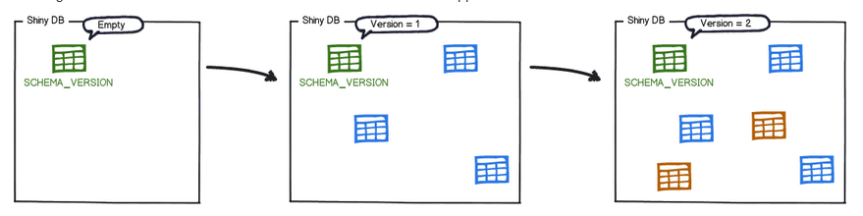
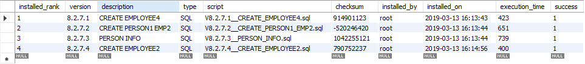
How it works?
Metadata table FLYWAY_SCHEMA_HISTORY
Each change is recorded in metadata table
The migrations are then sorted based on their version number and applied in order

Slide 5
With Flyway all changes to the database are called migrations. Migrations can be either versioned or repeatable.
Versioned migrations come in 2 forms: regular and undo.

Slide 6
VERSIONED MIGRATION
Versioned migrations have a version, a description and a checksum
The version must be unique. The description is purely informative for you to be able to remember what each migration does. The checksum is there to detect accidental changes.
Undo migrations are the opposite of regular versioned migrations. An undo migration is responsible for undoing the effects of the versioned migration with the same version.
Repeatable migrations have a description and a checksum, but no version. Instead of being run just once, they are (re-)applied every time their checksum changes.

Slide 7
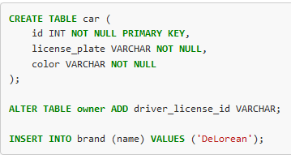
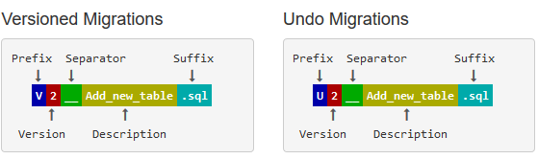
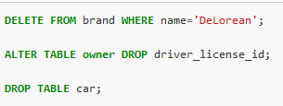

Slide 8
Naming convention of Versions done Manually
Prefix: V for versioned , U for undo and R for repeatable migrations
Version: Version with dots or underscores separate as many parts as you like (Not for repeatable migrations)
Separator: __ (two underscores)
Description: Underscores or spaces separate the words
Suffix: .sql
1
001
5.2
1.2.3.4.5.6.7.8.9
205.68
20130115113556
2013.1.15.11.35.56
2013.01.15.11.35.56

Slide 9
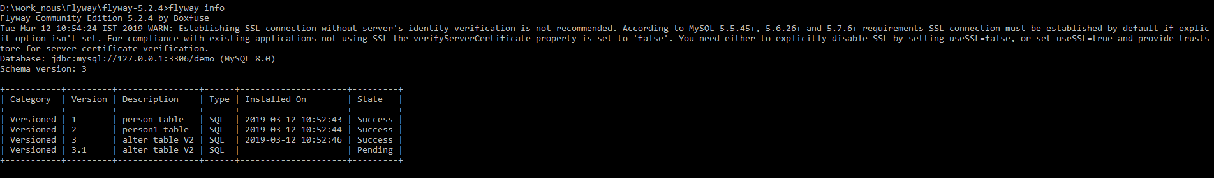
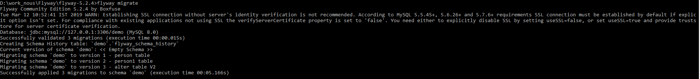
Info,migrate,clean
Info
Migrate
Clean

Slide 10
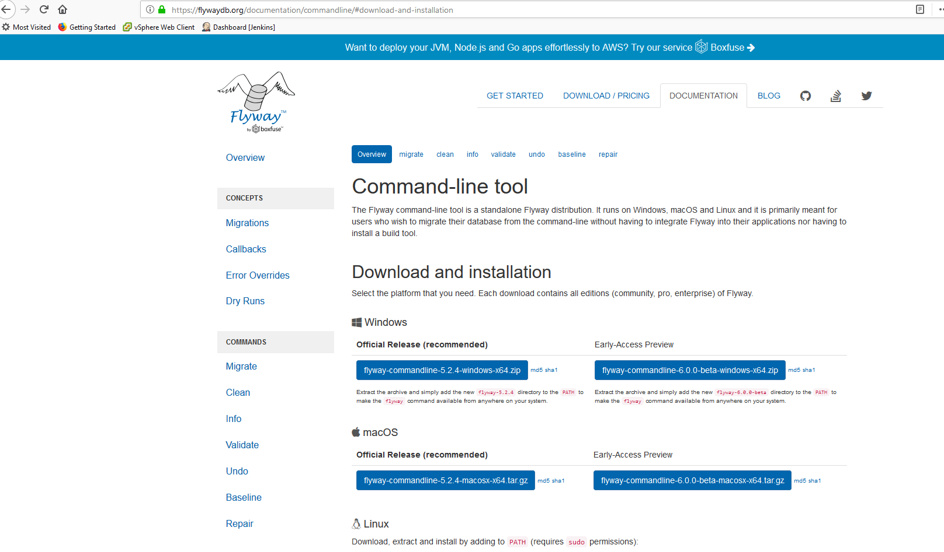
Download and Extract
Link: https://flywaydb.org/documentation/commandline/#download-and-installation

Slide 11
SCENARIOS
FRESH DB
EXISTING DB

Slide 12
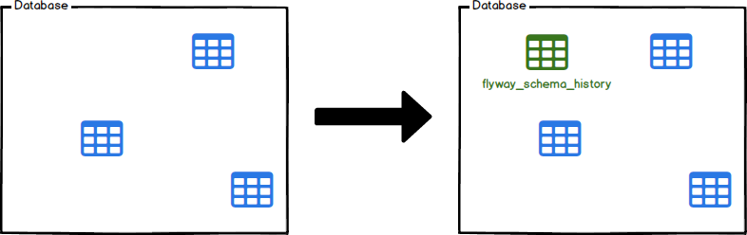
Existing DB baseline
Cmd: flyway -baselineVersion=VERSION baseline

Slide 13

DEV | QA | UAT | PROD
 | Q1(8.2.7) | U1(8.2.5) | P1(8.2.4)
 | Q2(8.2.6) | U2(8.2.6) | P2(8.2.3)
 |  | U3(8.2.5) | P3(8.2.4)
DB-TEAM

